Slide 1
BACHELOR OF TECHNOLOGY
IN
Artificial Intelligence and Machine Learning
Analysis of the tonality of texts based on machine learning methods
Yanamadala Chandra Shekar : 2011CS020435
Project Guide
Dr. P. Venkateshwara Rao
Department of AIML, School of Engineering
Malla Reddy University

Slide 2
Abstract
Sentiment analysis is a natural language processing technique that aims to identify and extract the emotional content and opinions expressed in text data. It involves analyzing the text for polarity, i.e., whether the sentiment expressed is positive, negative, or neutral.
Sentiment analysis has numerous applications in various domains, including marketing, customer service, politics, and healthcare. It is accomplished using various techniques, such as lexicon-based analysis, machine learning, and deep learning.
The accuracy of sentiment analysis depends on factors such as the quality of the data, the type of sentiment being analyzed, and the choice of the appropriate algorithms and models. Overall, sentiment analysis has proven to be a valuable tool in extracting insights from unstructured text data and improving decision-making in a wide range of applications.

Slide 3
Introduction
The ability to judge sentiment would be helpful when applied number of opinions found in growing number of news websites, tweets etc.
It would allow for organization of information into groups and make it easier for user to find and react to similar or opposite opinions thus improving and simplifying the process of sharing and discussing opinions .
Companies become much more efficient at communicating with their customers, by studying customer feedback,a company can discover public opinion about their products.

Slide 4
Literature Survey:
"Sentiment Analysis: A Comprehensive Survey" by Bing Liu (2012) - This paper provides a comprehensive overview of sentiment analysis, including its various subtasks, approaches, and applications. It also discusses the challenges and future directions of sentiment analysis research.
"A Survey of Sentiment Analysis Techniques" by Xiaowen Ding et al. (2018) - This paper reviews various techniques used in sentiment analysis, including lexicon-based, machine learning-based, and hybrid approaches. It also discusses the challenges and limitations of sentiment analysis and provides recommendations for future research.

Slide 5
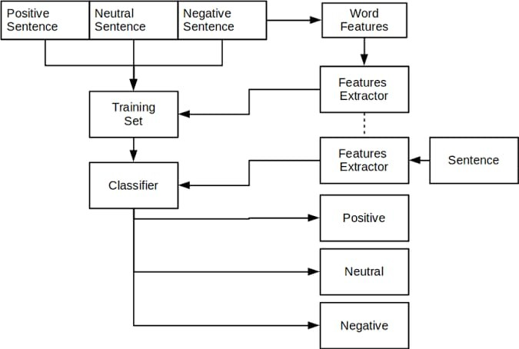
Proposed Methodology
Machine learning approaches use algorithms to train a model to classify the text into different sentiment or tonality categories.
The model is typically trained on a labeled dataset of text examples and learns to identify patterns and features in the text that are associated with each sentiment or tonality category.
Machine learning approaches can be highly accurate and adaptable, but may require significant amounts of training data and computational resources

Slide 6
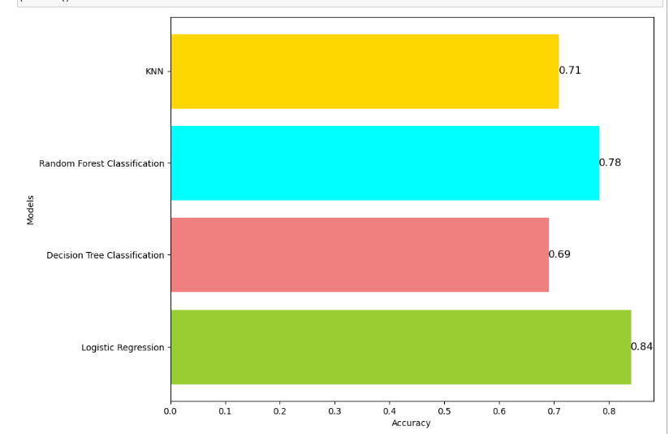
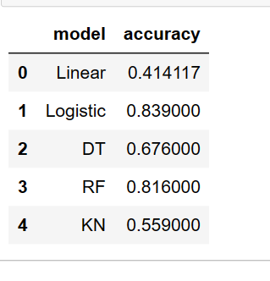
Results and Discussions

Slide 7
Conclusion
In conclusion, sentiment analysis using machine learning is a powerful technique that can provide insights into people's opinions and emotions about various products, services, or topics. By using various algorithms and models, it is possible to classify text data into positive, negative, or neutral sentiments.
The accuracy of sentiment analysis models can vary depending on the quality and quantity of the data used to train them. Therefore, it is essential to choose appropriate features and perform data preprocessing to achieve better results.
Overall, sentiment analysis using machine learning has many potential applications in marketing, customer service, and social media analysis. As the amount of digital data continues to grow, sentiment analysis will become increasingly important for businesses to gain insights into their customers' opinions and improve their products and services accordingly.

Slide 8
Thankyou
Batch-19

